Slide 1
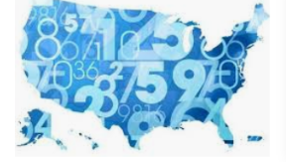
Machine Learning Modeling | Forecast US Census Income
Presented by: Sharonda Warner
January 28, 2020
Notes:
Predicting if income exceeds $50,000 per year.

Slide 2

Problem Statement
To predict whether an individual’s income will be greater than $50,000 per year or not given their demographic variations
Dataset based on 1994 US Adult Census data
This is a classification problem, based on a kernel in Kaggle
Notes:
2
The Dataset
The US Adult Census dataset is a repository of 32,61 entries and 15 columns extracted from the 1994 US Census database.
Question: Can we predict the income level of an individual given their demographic and social economic attributes?

Slide 3

Business Value
For Trade Schools and Professional school programs to identify jobs that pay $50,000 without a bachelor’s degree
Notes:
3
Jobs That Pay $50K Without a Bachelor's Degree
Want to make a decent living without spending many years in college? Jobs that pay $50K or more a year and don't require a four-year degree are easier to find than you might think.
Candidates, based on age, education and martial status
Offer programs, based on occupation and work class
Used in marketing campaigns, to convey program offers where individual income is greater than $50,000 can be achieved

Slide 4

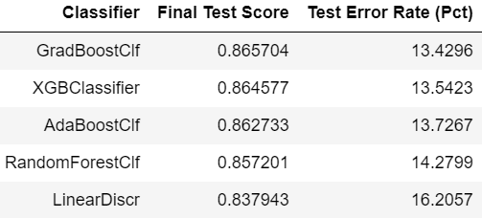

Methodology
Use Machine Learning modeling to predict, if income exceeds $50,000
Analyze the following datapoints from census data :
age, race, gender, occupation, work class, hours per week, education, marital status and country of origin for an individual
Number of entries total 32,561
Notes:
4
Kernel from Kaggle
Predicting if income exceeds $50,000 per year based on 1994 US Census Data.
Abstract:
For this assignment, we examine the Census Income dataset available at the UC Irvine Machine Learning Repository. We aim to predict whether an individual’s income will be greater than $50,000 per year based on several attributes from the census data.
GradBoostClf | has the lowest percent prediction error when evaluating against the test data set: 13.4296%

Slide 5
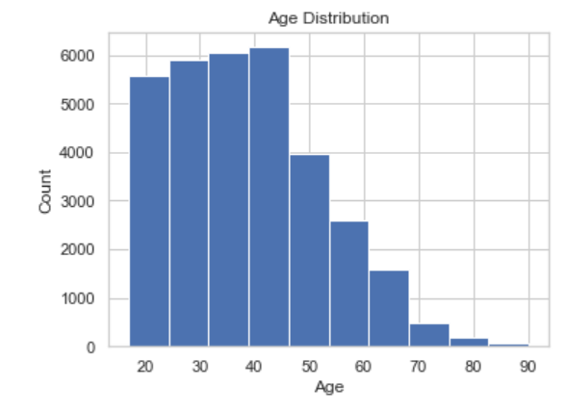
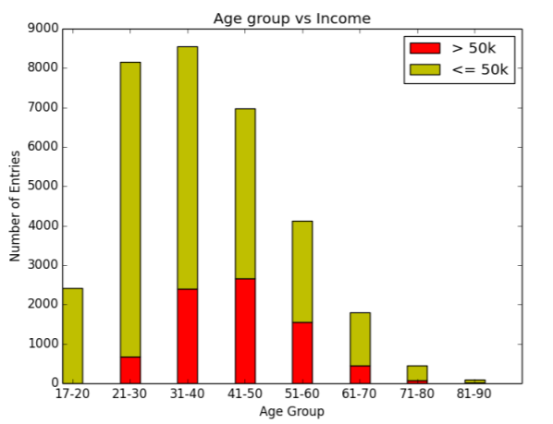
Age
Ages range from 17 to 90 years old
Majority of entries between the ages of 25 and 50 years
Between Ages: 17­, 20, 71­-80, and 81­-90 individuals have no chance of having an income of greater than $50,000
Notes:
5

Slide 6
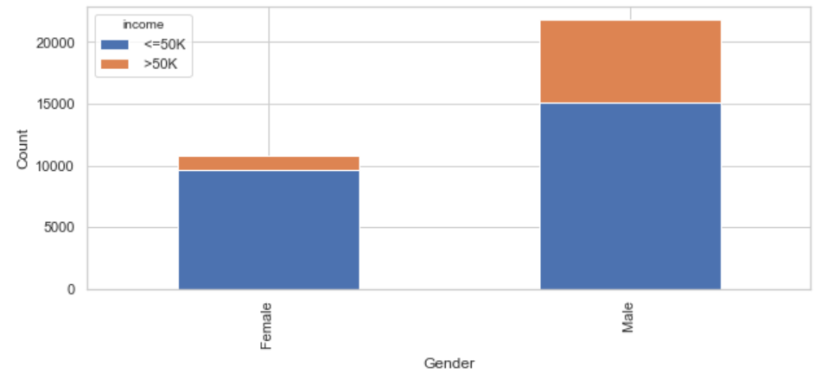
Gender
67% of the individuals in the dataset are Male
The sample size of males in comparison to females in the dataset are almost double
Percentage of males who make greater than $50,000 is much greater than the percentage of females

Slide 7
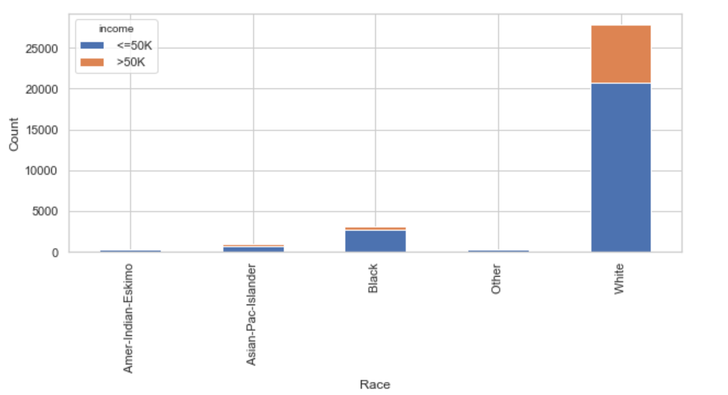
Race
85% of the individuals in the dataset are White
Whites have a larger percentage of individuals making more then $50,000 than the rest of the races
The second most represented group is Blacks with less than
5000 individuals (9.5%)
Notes:
The sample size of Whites in the dataset is disproportionately large in comparison to all other races. The second most represented group is Blacks with less than 5000 entries. The lack of equal distribution caused us to consider not utilizing this attribute in our prediction model.

Slide 8
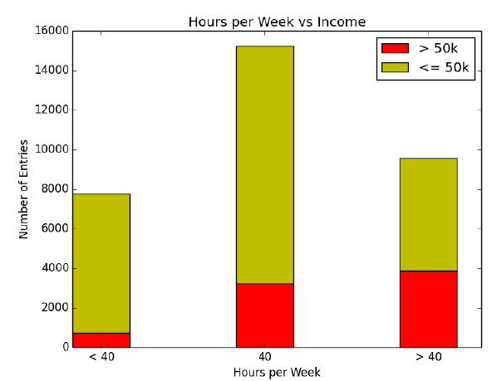
Hours Per Week
Less than 40 hours per week individuals making over $50,000 dramatically decreases
More than 40 hours per week individuals making over $50,000 increases significantly

Slide 9
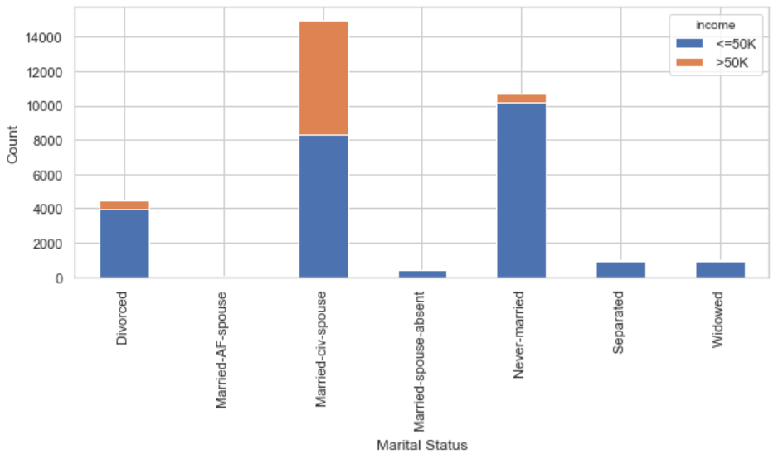
Martial Status
Married Civilian Spouse has the greatest impact on income greater than $50,000
Never Married individuals make income less than $50,000

Slide 10
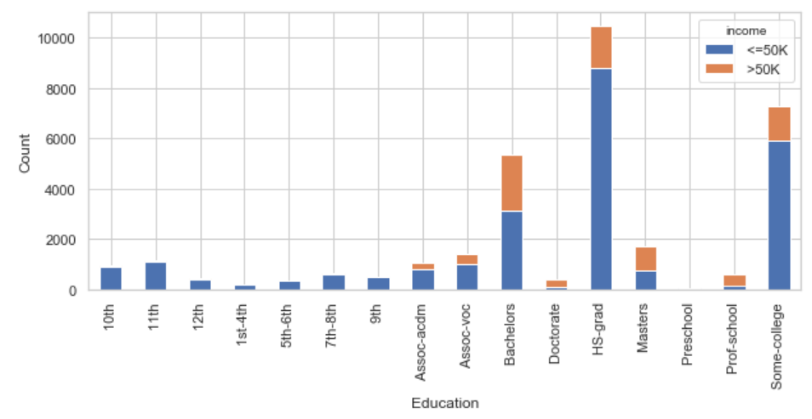
Highest Level of Education
Most of the individuals have a high school education
Only a small portion have a doctorate degree
Higher level of education is correlated to a higher percentage of individuals making $50,000
Notes:
Value Proposition: For Trade Schools and Professional school programs to identify jobs that pay $50,000 without a bachelor’s degree

Slide 11
Findings and Recommendations
Gradient Boost Classification worked the best out of all our models giving the "highest" :
Most Predictive Features:
Number #1 predictor was ‘Married Civilian Spouse ’
Others: ‘age’, ‘education’, ‘hours/week’, ‘occupation’, and ‘gender’
Scoring Metric | Value
Test Accuracy Score | 86.6%
Test Error Rate | 13.4%
Precision (Micro Avg) | 87%
Notes:
GradBoostClf | has the lowest percent prediction error when evaluating against the test data set: 13.4296%

Slide 12
Future Work
Obtain updated US Adult Census dataset to evaluate income
Perform cluster analysis on income segment < 50K to gain more insights on customer profile
Notes:
Approx. 75% of the data are that of individuals <= $50,000 which may attributed to high bias in the dataset.
The number of samples from individuals identifying as ‘White’ was severely disproportionate to even the sum of all of the rest of the samples in the data set -- myabe, we chose to ignore this feature.

Slide 13
Thank you !
Learn-co.slack.com
@Sharonda W

Slide 14
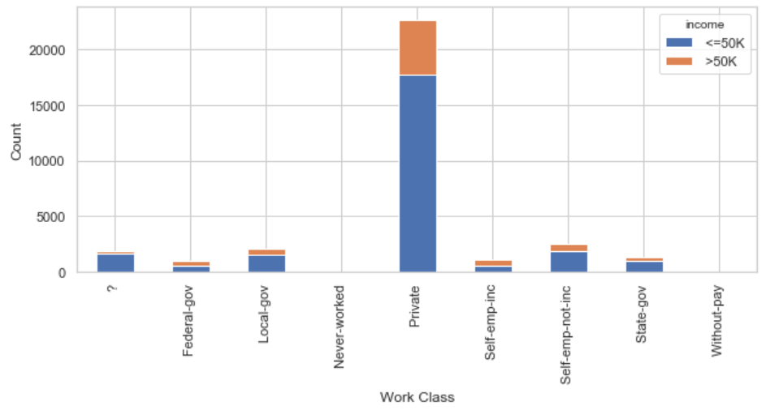
Work Class
Majority of the individuals work in the private sector
Probability of making above $50,000 look similar among the work classes
Notes:
The majority of the individuals work in the private sector. The one concerning statistic is the number of individuals with an unknown work class. The probabilities of making above $50,000 are similar among the work classes except for selfempinc and federal government. Federal government is seen as the most elite in the public sector, which most likely explains the higher chance of earning more than $50,000.
Selfemployedincorporated implies that the individual owns their own company, which is a category with an almost infinite ceiling when it comes to earnings.

Slide 15
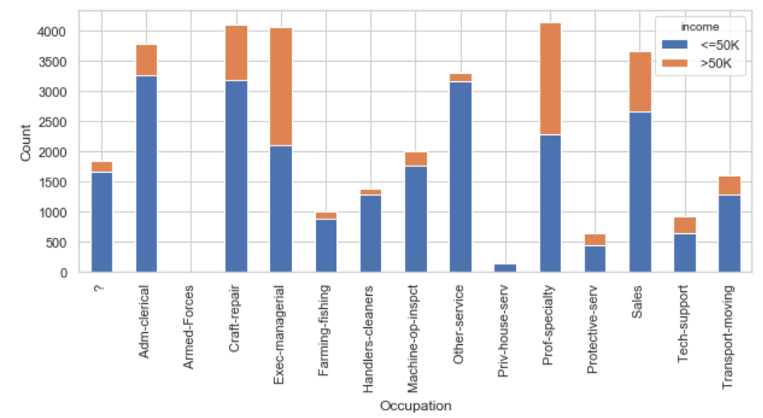
Occupation
Chart shows a uniform distribution of occupations
Executive Mgrs. and Prof Spc. have very high percentages of individuals making over $50,000
Percentages for Farming-fishing, Other-srv and Handlers-cleaners are significantly lower than the rest of the distribution

